Slide 1

Automatic Labelling and Sector Hypothesis of 500 S&P stocks
By Nitish Asthana

Slide 2
Agenda
Introduction and Problem Statement
Deliverables
Expectations
Data
Exploration and Insights
Labelling Strategy
Data Flow Diagram
Modelling Strategy
UI Demo
Hypothesis Testing and Exploration
Clustering Insights and Correlation
End

Slide 3
Introduction and Problem Statement
Introduction:
Problem Statement:
The S&P 500 comprises around 500 stocks that represent a broad spectrum of sectors in the market. While it's expected that stocks within the same sector may move in sync due to similar economic drivers, the hypothesis is that there could be stock groups across unrelated sectors that exhibit similar price behaviors.
Automatically classify stocks as up, down, or flat over a 2-year window, accounting for temporary spikes, long-term trends, and recent shocks. Develop an effective labeling methodology and quantify the accuracy of this classification to ensure reliable detection of stock movement patterns.

Slide 4
Deliverables
An automated approach to label stocks into major categories Up/Down/Flat over two-year window.
A presentation summarizing the analysis, methodology, results, and conclusions.
A complete codebase demonstrating the labeling strategy for stock classifications

Slide 5
Expectations…
What this is?
A working demo/proof of concept built using Python that automatically labels stocks as up, down, or flat based on daily and long-term trends, using publicly available S&P 500 data.
A well-designed labeling strategy and machine learning models to analyze stock movements.
A user-friendly interface that visualizes stock trends and helps users understand movement patterns—focused purely on knowledge and insights.
What this is not!
A tool for predicting stock movements before market open or over long-term horizons.
A platform for speculative trading or financial advice.

Slide 6

Data

Slide 7
Data Sources and Features
Timeline
From Sep’2022 – Oct’2024
Historical Daily Data:
Yahoo Finance
Alpha-vantage
Stock List:
Wikipedia
Related information:
General internet sources for industry, sector, and macroeconomic context
Tools:
APIs (for data collection)
Web Scraping (for stock list and related info)
Python libraries such as talib, scipy, and others for feature extraction
Total Data Point: 250K Rows
Approx. ~500 Trading Days
Features in Raw Data
Daily Timeseries data
Ticker/Stock Name
Price
Open
Close
Low
High
Volume
Sector
Industry
Extracted Features:
Price-Based Features:
Open, High, Low, Close Log_Return
Moving Averages:
SMA_50 (Simple Moving Average, 50 days)
EMA_20 (Exponential Moving Average, 20 days)
Momentum Indicators:
RSI (Relative Strength Index)
RSI_14, RSI_28 (RSI calculated over different periods)
MACD (Moving Average Convergence Divergence) MACD_Signal
Bollinger Bands:
BB_upper (Upper Bollinger Band)
BB_lower (Lower Bollinger Band)
BB_Pct (Percentage relative to Bollinger Bands)
Volume-Based Features:
OBV (On-Balance Volume)
OBV_SMA_ratio (OBV to SMA ratio)
Volume_Lag_1 to Volume_Lag_5 (Lagged volume over the past 5 days)
Lagged Price Features:
Close_Lag_1 to Close_Lag_5 (Lagged closing prices over the past 5 days)
Volatility and Range:
Volatility (Price volatility over time)
ATR (Average True Range)
High_Low_Range (High-Low price range)

Slide 8
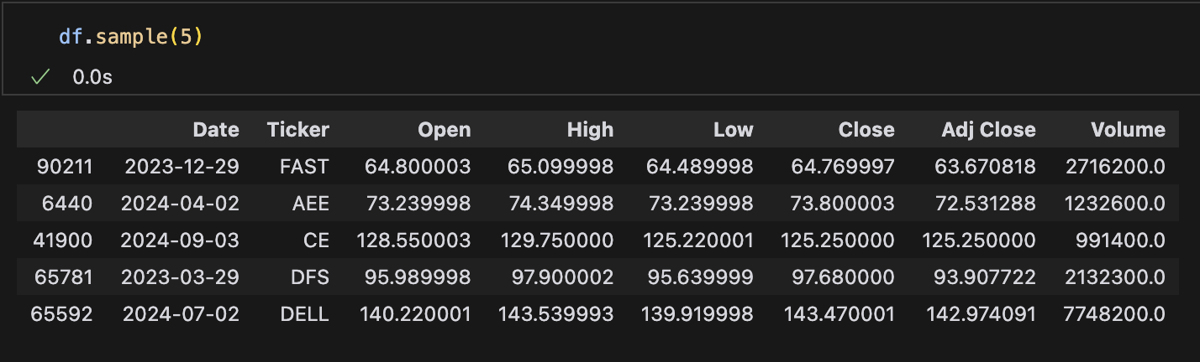
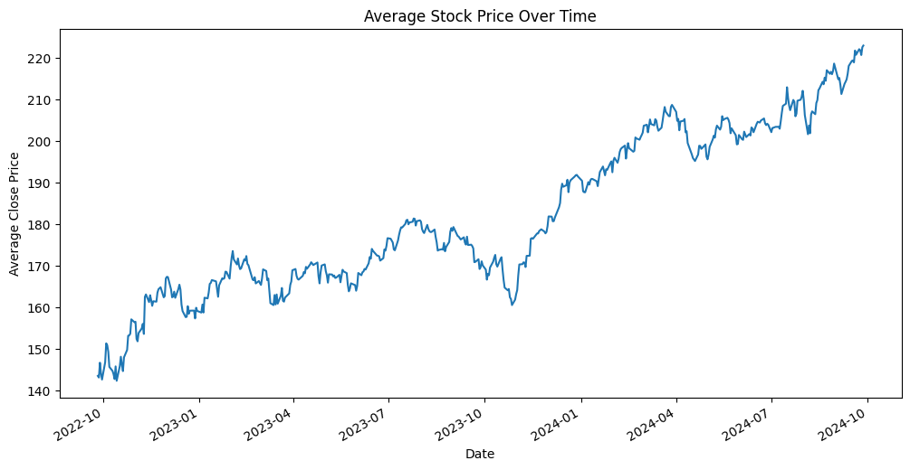
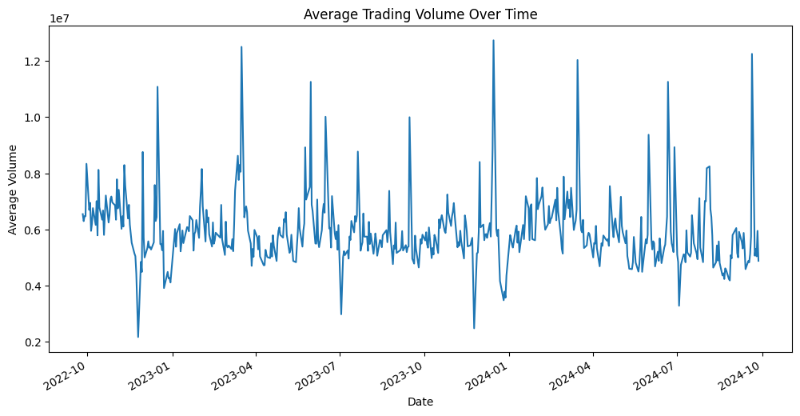
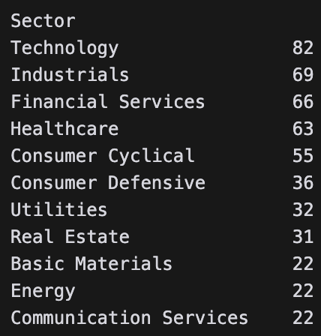
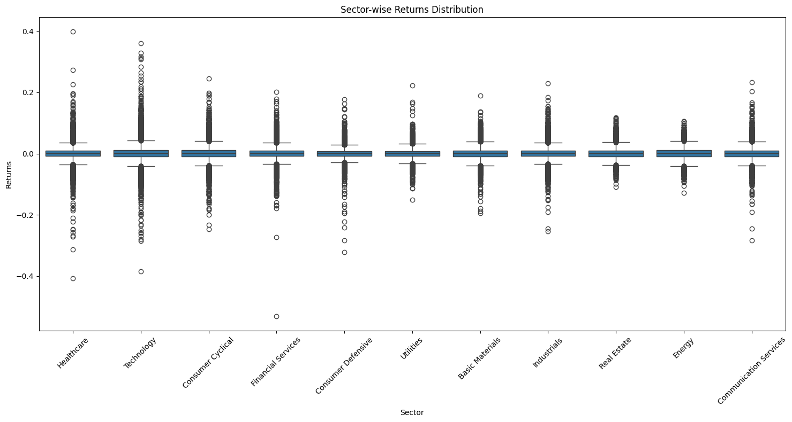
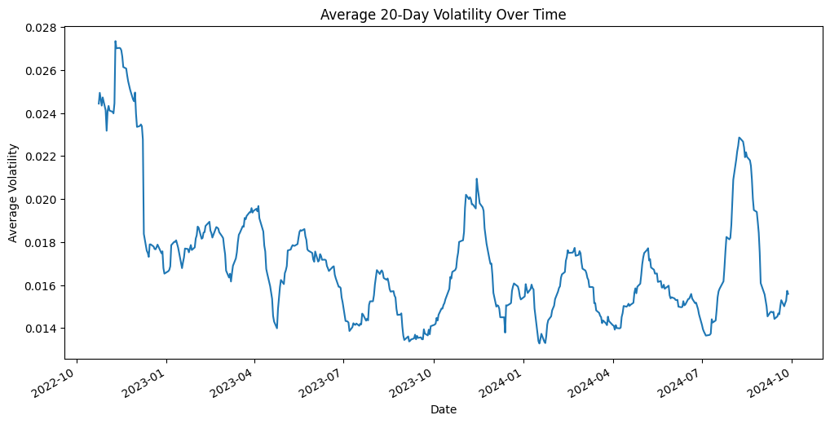
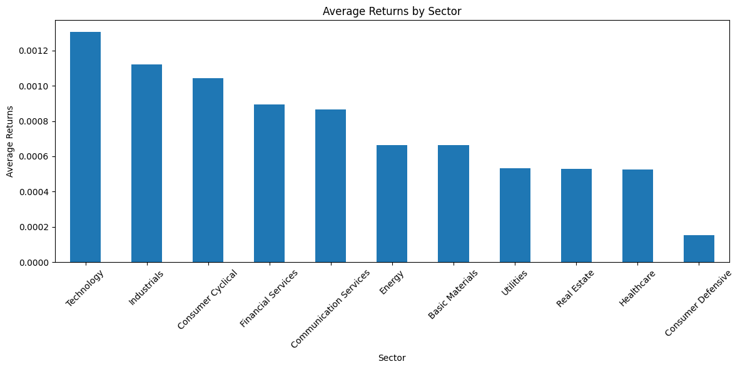
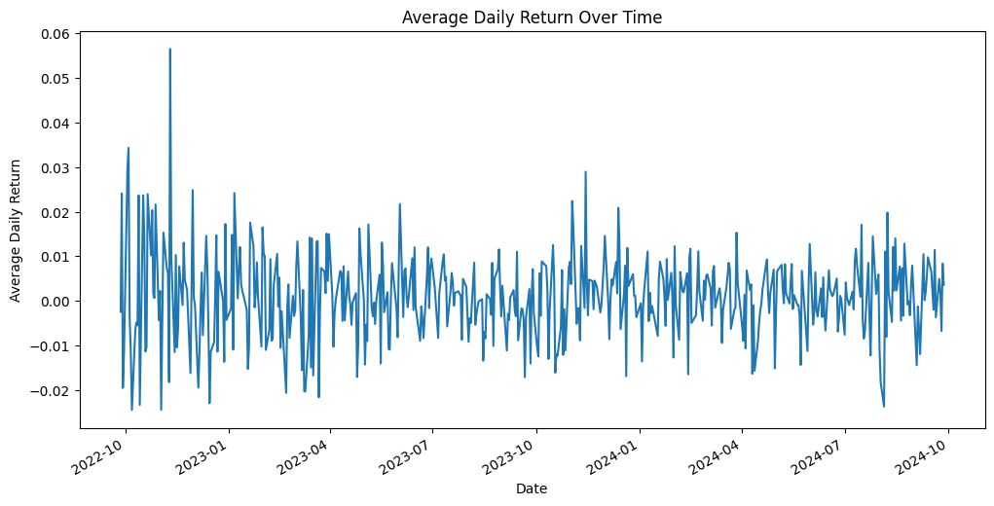
Data Exploration and EDA

Slide 9
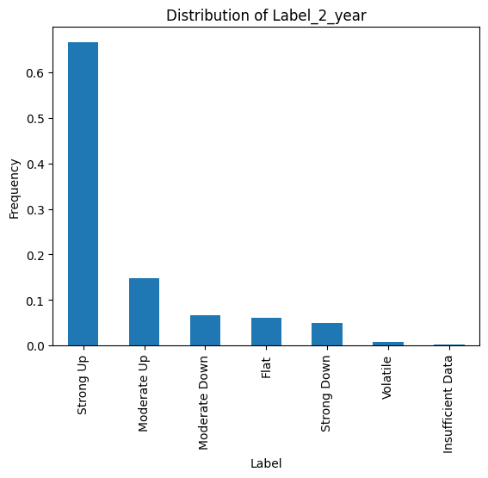
Labelling Strategy
Classify Stocks
Strong UP
Weak Up
Flat
Weak Down
Strong Down
Key Features Used for Labeling:
Relative Strength Index (RSI):
Detects overbought (>70) or oversold (<30) conditions.
Helps predict potential trend reversals.
Momentum:
Measures the speed of price changes.
Indicates trend strength (gaining or losing momentum).
Bollinger Bands:
Identifies volatility and price breakouts.
Helps spot overbought/oversold levels based on standard deviation from the average.
Moving Averages (SMA/EMA):
Smooths out price trends over time.
Tracks whether the stock is trending upward or downward.
MACD (Moving Average Convergence Divergence):
Shows momentum changes.
Helps identify trend shifts when MACD crosses its signal line.
Average True Range (ATR):
Measures daily volatility.
Higher ATR means more volatility, lower ATR suggests stability.
52-Week High/Low Distance:
Shows where the current price is relative to its highest/lowest point over the past year.
Indicates potential breakouts or support/resistance levels.
Trend Identification:
RSI, Momentum, and MACD determine if the trend is strong, weak, or flat.
Bollinger Bands and Moving Averages confirm price direction or sideways movement.
Volatility Check:
ATR helps assess whether the price movement is volatile or stable.
The stock’s proximity to its 52-week high/low provides additional context.
Label Assignment:
Strong Up: High RSI, positive MACD, strong momentum, breaking above moving averages.
Weak Up: Moderate RSI, upward trend but less aggressive.
Flat: Neutral RSI, low momentum, price stuck near averages.
Weak Down: RSI dropping, fading momentum, gentle downtrend.
Strong Down: Low RSI, negative MACD, strong downward momentum
Criteria
Strong Up: High total return (>20%), strong RSI (>60), and price near or above moving averages or the 52-week high.
Weak Up: Moderate return (>5%), RSI between 50-60, and positive momentum.
Flat: Neutral RSI (40-50), low momentum, and price near moving averages, indicating consolidation or sideways movement.
Weak Down: Negative return (<-5%), declining RSI (40-50), fading momentum, and price falling toward the 52-week low.
Strong Down: Large negative return (<-20%), low RSI (<30), negative MACD, and strong downward momentum breaking below moving averages or the 52-week low.
Volatile: Stocks with volatility above 0.4 are labeled volatile regardless of trend direction

Slide 10

Model

Slide 11

Models and Metrics
Data Preparation & Labeling:
Started with 7-class labeling for stock movements but simplified it to a 5-class system for better model performance and interpretability.
Applied feature selection, label encoding, and ensured clean data for model input.
Model Training & Evaluation:
Used time-series cross-validation to test models on unseen data in a temporal sequence.
Trained multiple models (Random Forest, XGBoost, Neural Networks) and compared performance based on accuracy and other key metrics.
Performance Analysis:
The 5-class system outperformed the original 7-class system, providing clearer and more accurate classifications.
Generated confusion matrices, classification reports, and evaluated performance across cross-validation folds.
Optimization:
Developed an optimized training script and retrained models with the 5-class system, yielding better results.
Persisted the best model for future use. Saved based model for inferencing.
Feature Importance:
Analyzed feature importance to understand model behavior and improve interpretability.
Handling Class Imbalance:
Addressed class imbalance, particularly in the "Flat" category, by applying techniques like resampling and focusing on F1 scores.
Results Comparison:
The transition from 7-class to 5-class labeling improved classification performance, especially for under-represented classes, enhancing precision and recall.

Slide 12
Models and Metrics Cont.
Model Accuracy
Random Forest (7-Class): 51.33% (struggled with class imbalance)
XGBoost (7-Class): 52.88% (slight improvement)
Final Model (5-Class): 92% (major improvement after simplifying classes)
F1-Score (Balancing Precision & Recall)
Random Forest (7-Class):
Macro: 0.25 (poor performance, imbalance impacts minority classes)
Weighted: 0.57 (dominated by majority classes)
XGBoost (7-Class):
Macro: 0.20
Weighted: 0.53 (also dominated by majority classes)
Final Model (5-Class):
Macro: 0.91 (balanced performance across classes, even minority)
Weighted: 0.92 (well-distributed performance)
Precision & Recall
7-Class Models:
Near-zero precision and recall for minority classes
Misclassified most rare events as majority class (Class 4)
5-Class Model:
Precision & recall ~0.90-1.00 across all classes
Especially better at capturing minority events (e.g., strong downtrends)
Confusion Matrix Analysis
7-Class System: Struggled to separate minority classes, misclassified frequently
5-Class System:
Improved separation and accuracy, fewer misclassifications
"Flat" and "Weak Down" classes show much clearer distinctions
Key Takeaways
7-Class System: Performance heavily impacted by class imbalance
5-Class System:
92% Accuracy and F1-Score of 0.91
Balanced performance across all metrics
Crucial improvement for financial predictions with rare events (e.g., strong downtrends)
Class Distribution
Final Confusion Matrix

Slide 13
Data Flow Diagram and Architecture Design
Data Ingestion:
Import CSV data containing S&P 500 stock information
Feature Engineering:
Price Features
Volume Features
Moving Averages
Derived Features
Labeling Strategy:
2-Year Label: Long-term trend classification
Daily Label: Short-term trend classification
Model Training:
Algorithm: XGBoost/Random Forest
Input: Daily labels and engineered features
Visualization:
Display Trends using Interactive Plots and Data Points
Create stock UI for user interaction
Stock Selection interface
Model Evaluation:
Performance Metrics
Top 15 Important Features
Error Analysis
Model Scoring
Daily Label Prediction

Slide 14
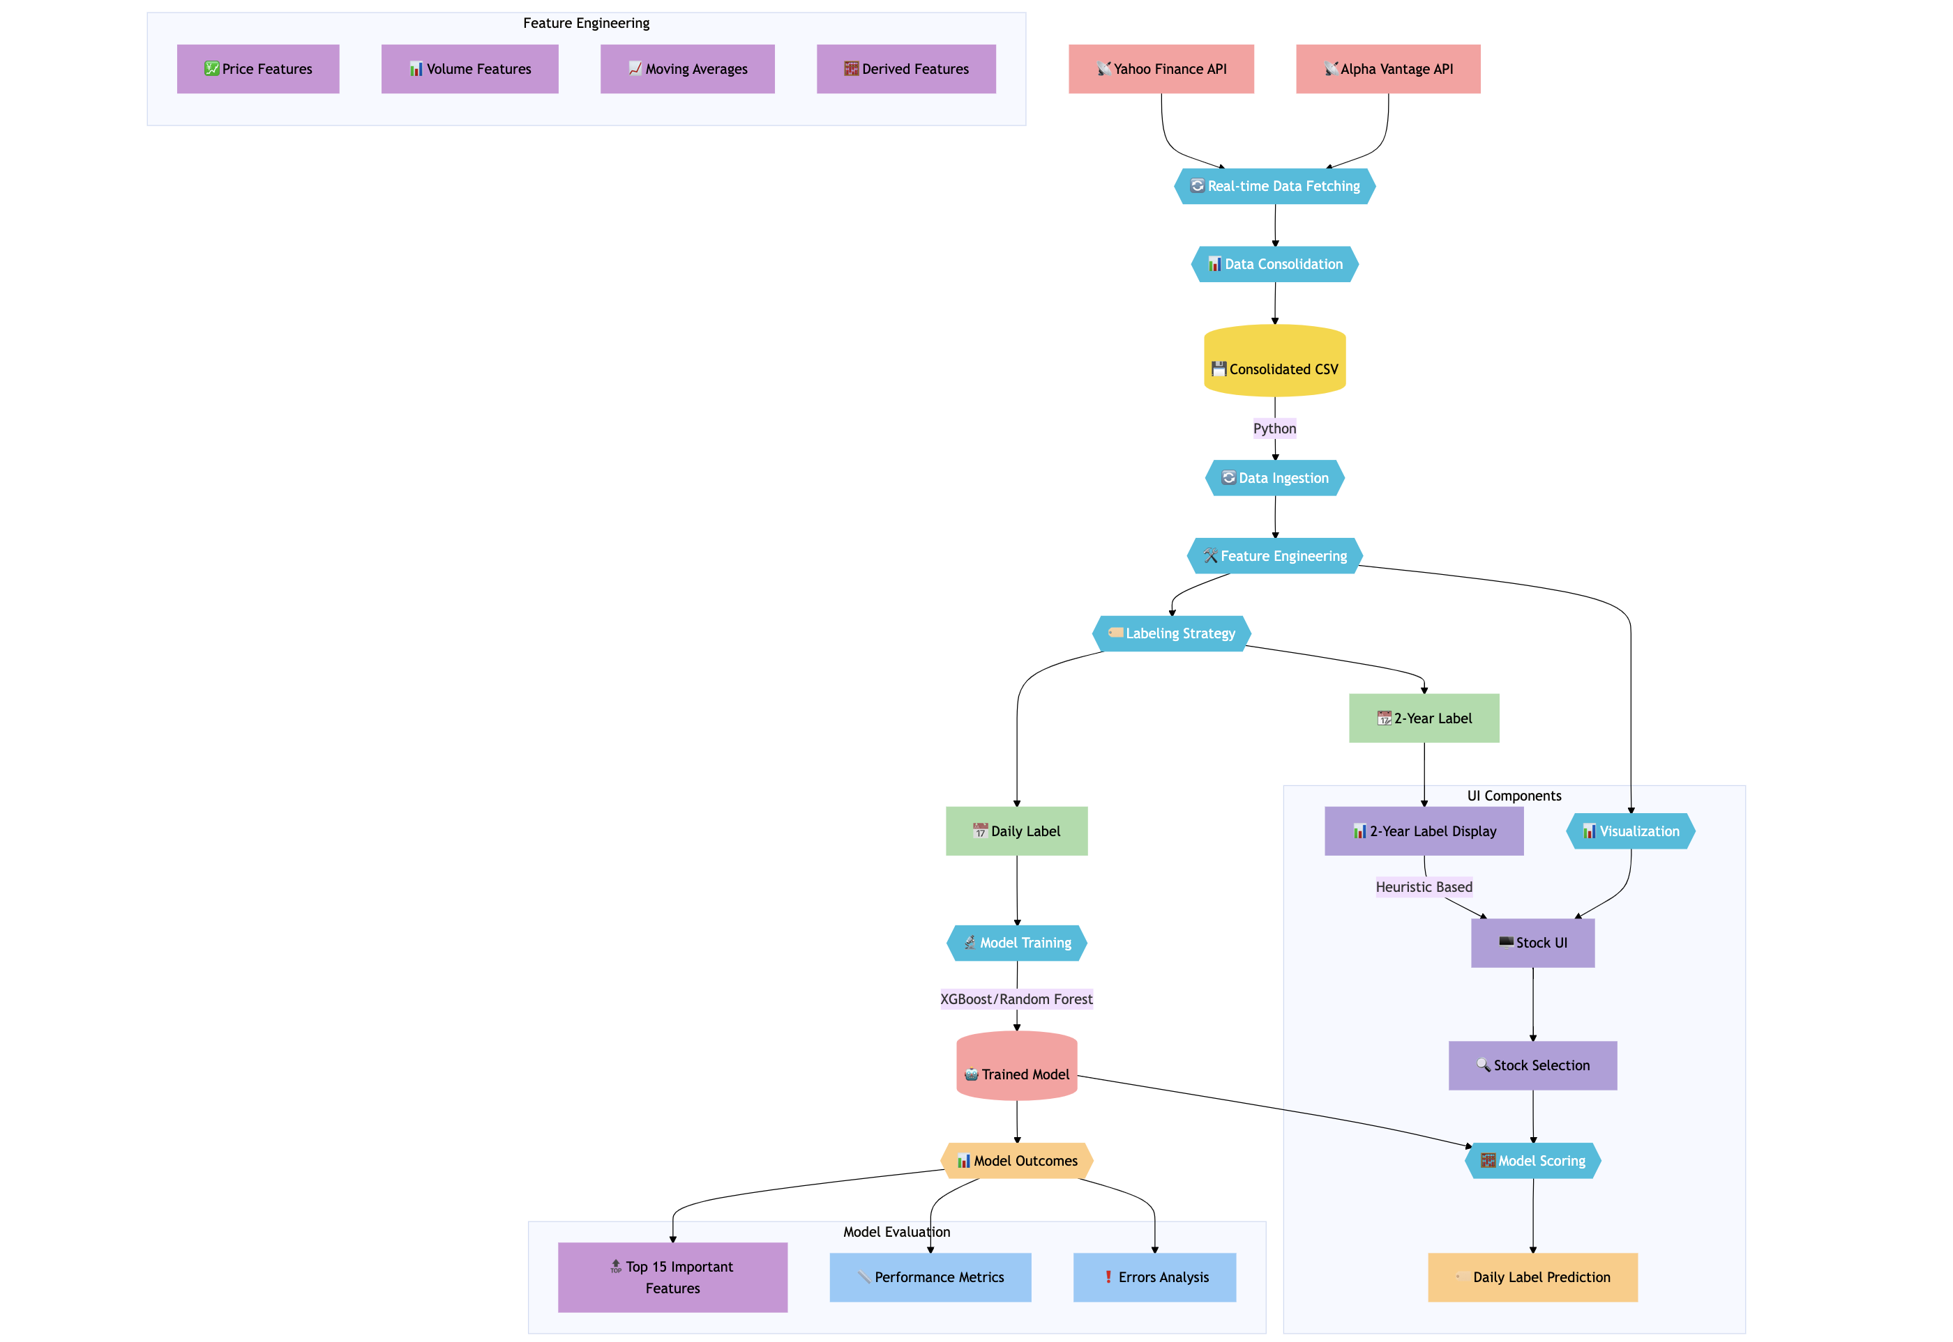
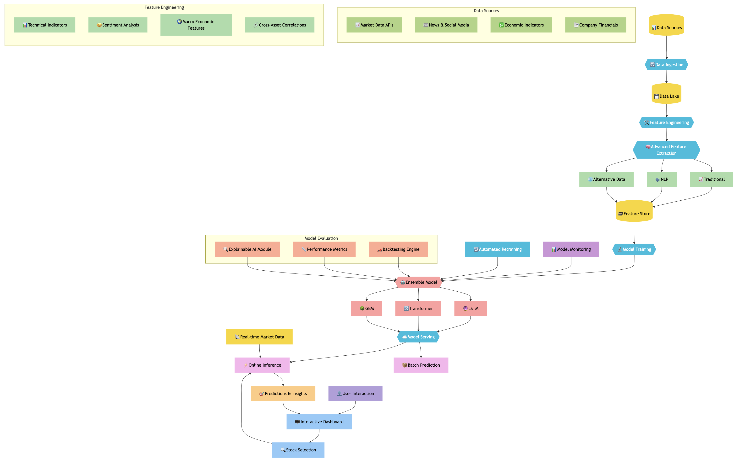
Current Design to the Future Design Enhancements
Current Design
Future Design

Slide 15
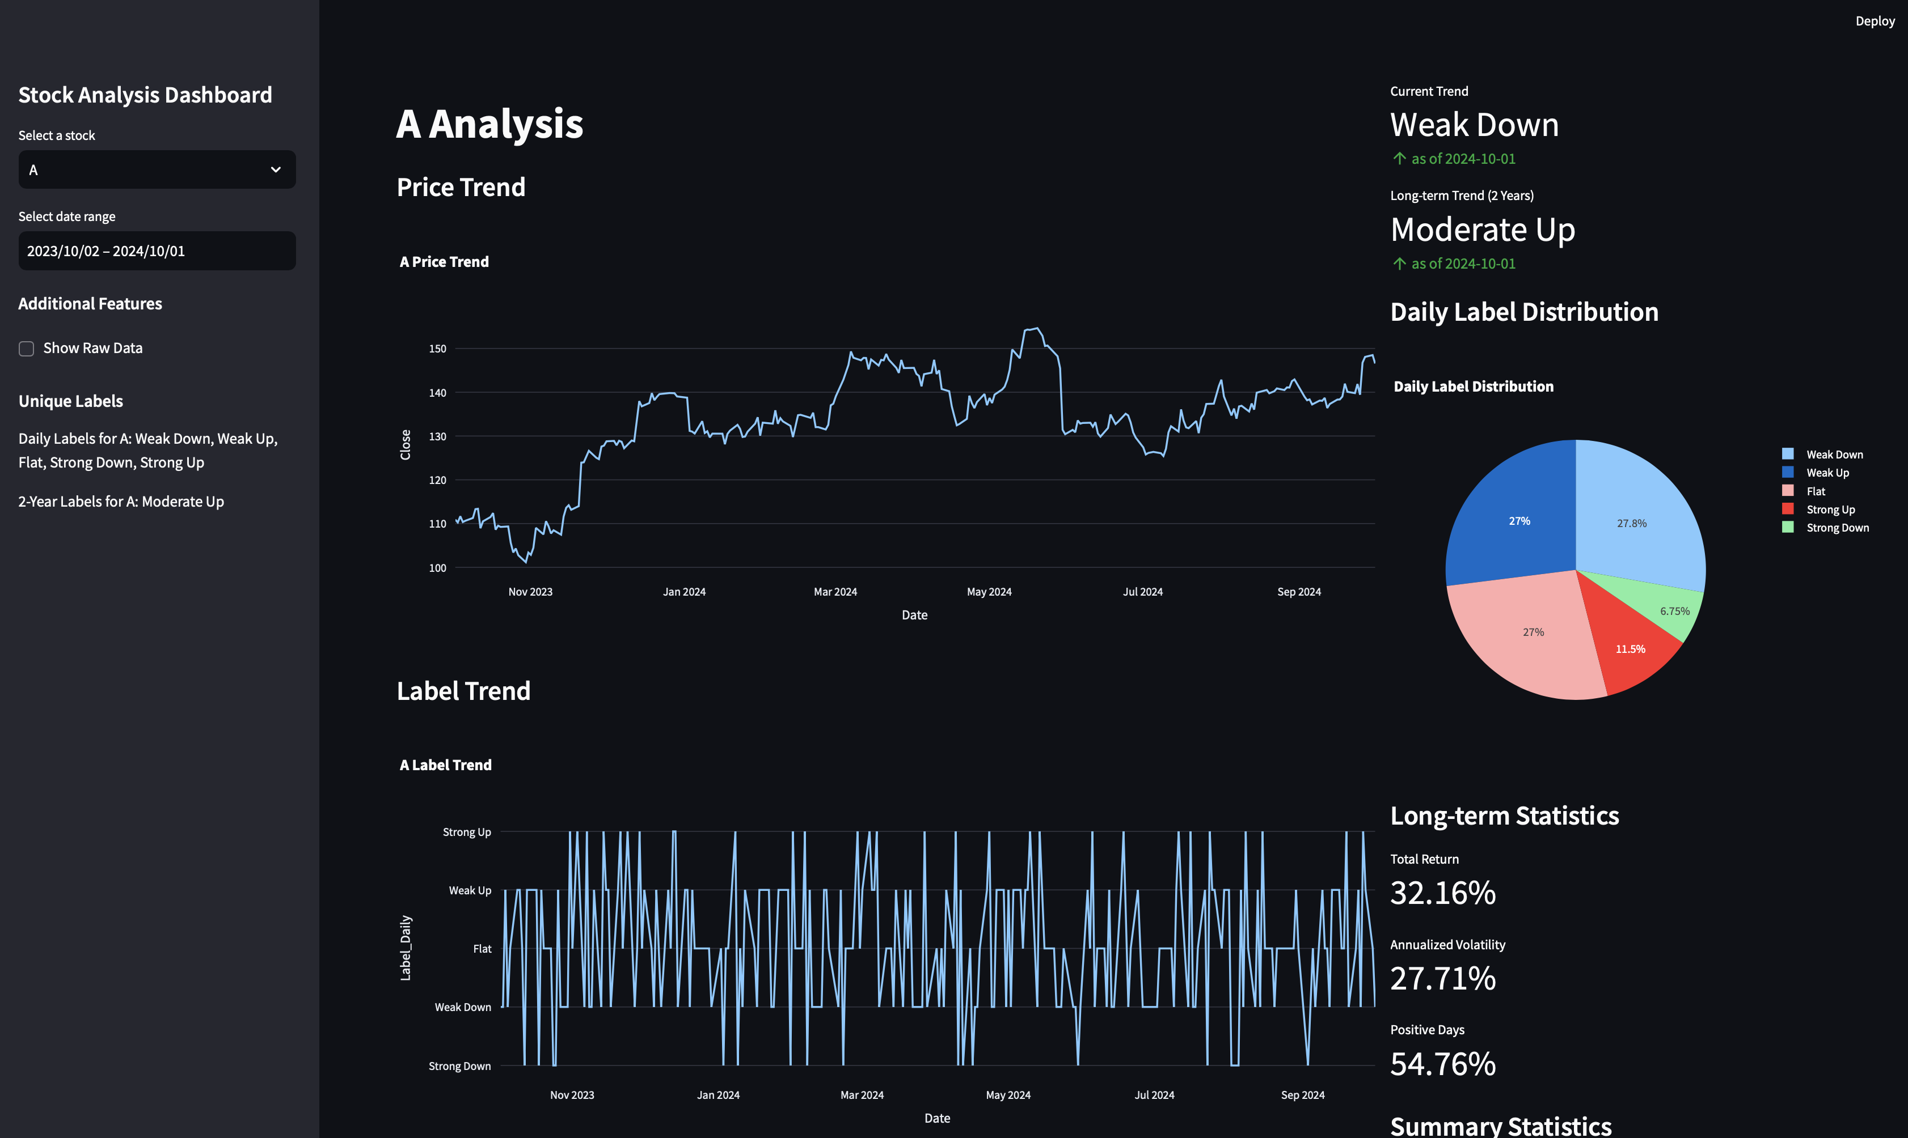
User-Interface

Slide 16

Sector Hypothesis

Slide 17
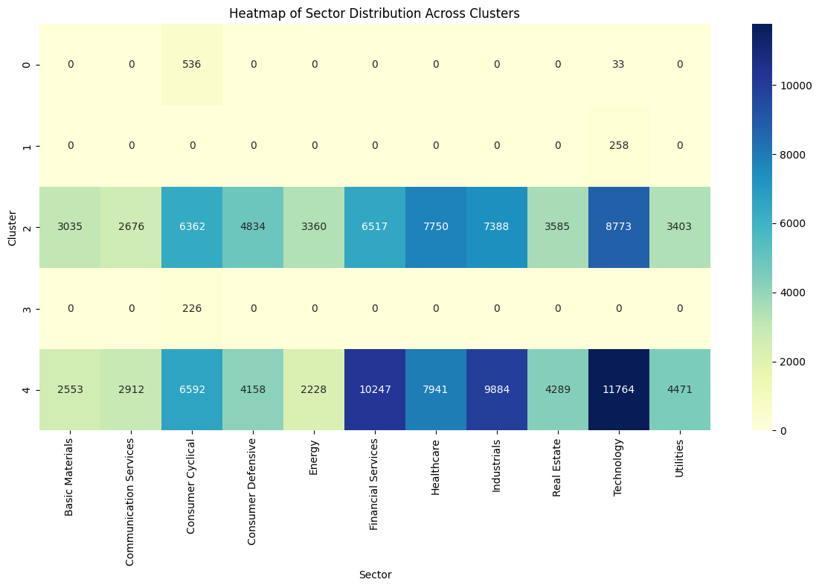
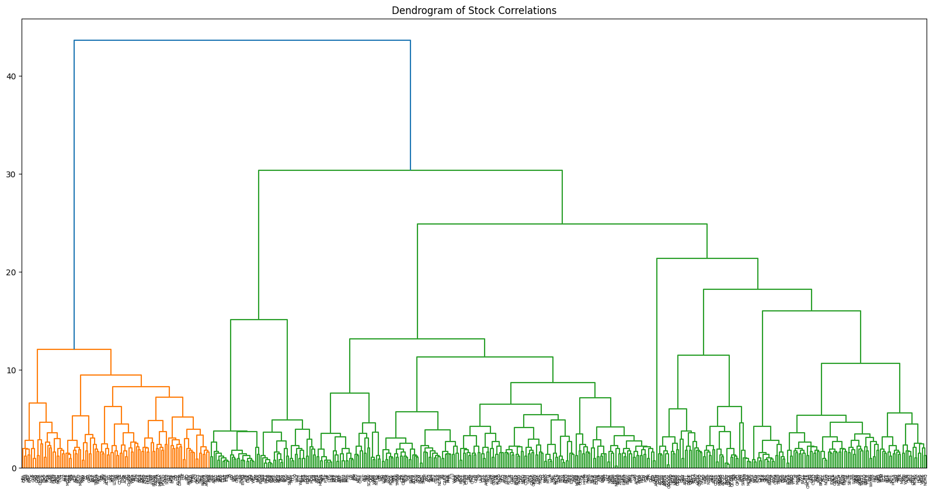
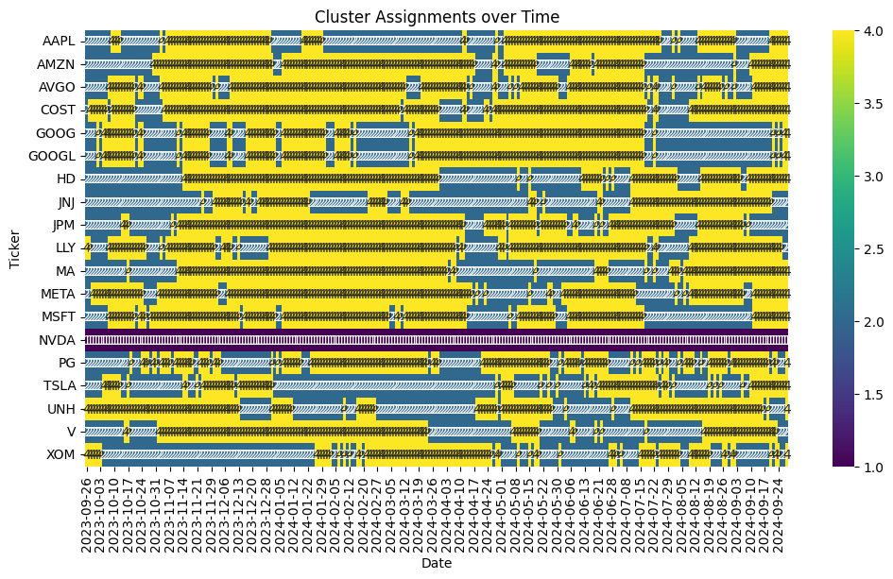
Exploring Stock Clustering in the S&P 500
Clustering and Feature Importance Results
Stocks can be grouped into clusters based on technical characteristics and price momentum, regardless of sector affiliations
RSI emerges as the most important feature in predicting stock clusters, outweighing traditional sector classifications
Technical indicators (RSI, MACD, Bollinger Bands) dominate over fundamental factors
Conclusion and Key Takeaways
Stocks can be grouped into clusters based on technical characteristics and price momentum, regardless of sector affiliations
RSI is the most important feature in predicting stock clusters

Slide 18
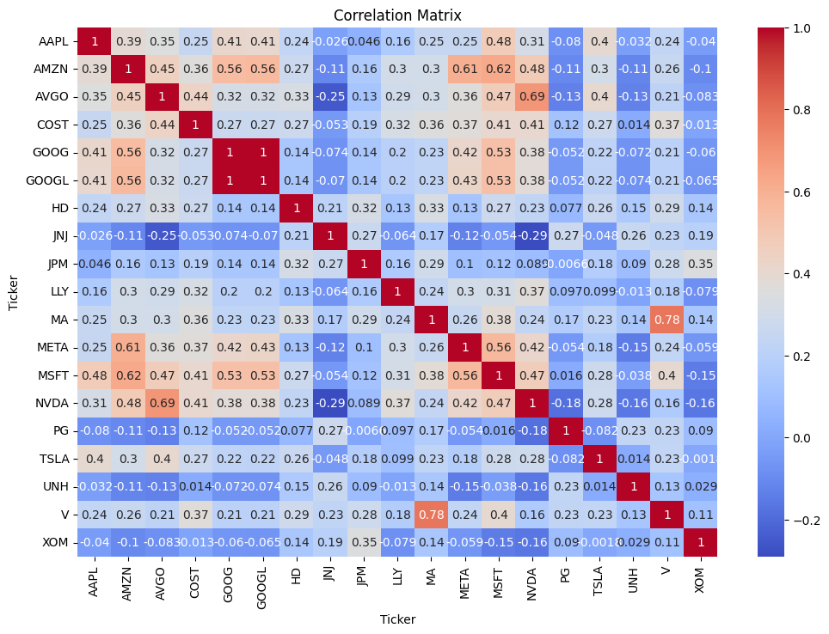
Exploring Stock-Sector Synchronization
Sector-Based Correlations
Intra-Sector Average Correlation: 0.374
Inter-Sector Average Correlation: 0.173
Statistically significant difference (p-value: 0.00314)
Example: GOOG and GOOGL (both Sector 1) correlation: 0.998
Cross-Sector Relationships
Some strong correlations observed between different sectors
Example: AMZN (Sector 2, Consumer Discretionary) and MSFT (Sector 9, Technology) correlation: 0.624
Example: COST (Sector 3, Consumer Staples) and NVDA (Sector 9, Technology) correlation: 0.408
Unexpected Groupings
Tech companies show high correlations across sectors Example: META (Sector 1, Communication Services) and AMZN (Sector 2, Consumer Discretionary) correlation: 0.606
Financial sector stocks correlate moderately with various sectors Example: JPM (Sector 5, Financials) and XOM (Sector 4, Energy) correlation: 0.34
Implications for Hypothesis
Sector Influence Confirmed
Higher intra-sector correlations support traditional sector-based analysis
Example: V and MA (both Sector 5, Financials) correlation: 0.778
Evidence of Cross-Sector Synergies
Strong correlations between certain stocks from different sectors suggest the existence of non-sector-based groups
Example: AMZN (Consumer Cyclical), GOOG (Communication Services), and MSFT (Technology) all have correlations > 0.5 with each other
Complex Market Dynamics
Findings indicate that stock movements are influenced by factors beyond simple sector categorization
Example: TSLA (Sector 2, Consumer Discretionary) shows varied correlations across sectors, from 0.404 with AVGO (Semiconductor/Technology) to -0.082 with PG (Sector 3)
Further Exploration Needed
Cluster analysis or network analysis could reveal more nuanced groupings
Investigation into common factors driving cross-sector correlations (e.g., growth characteristics, market cap, global exposure)
Example: COSTCO (Consumer Staples) correlates relatively highly (0.408) with tech stocks like MSFT and NVDA

Slide 19

QnA

Slide 20

Thank You!

Slide 21

Appendix

Slide 22
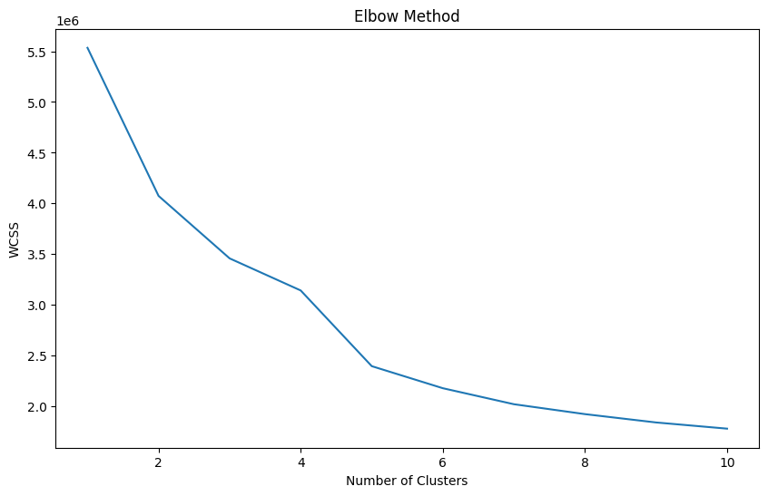
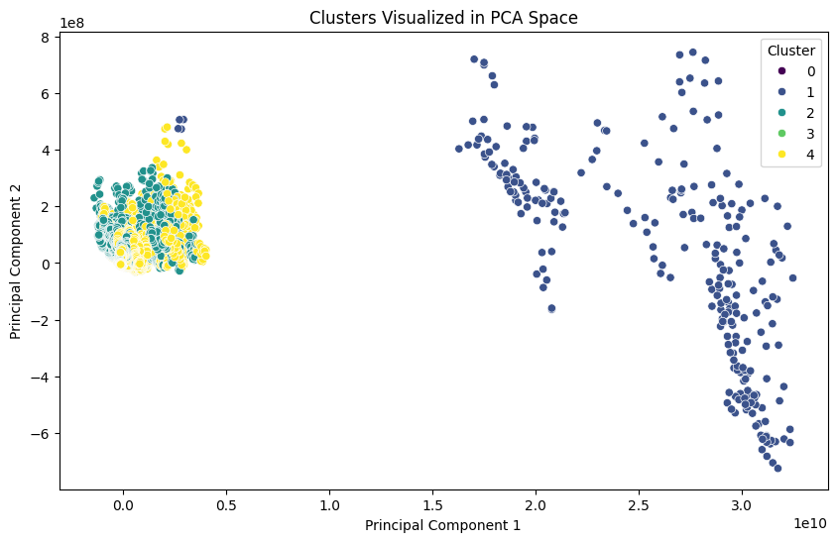
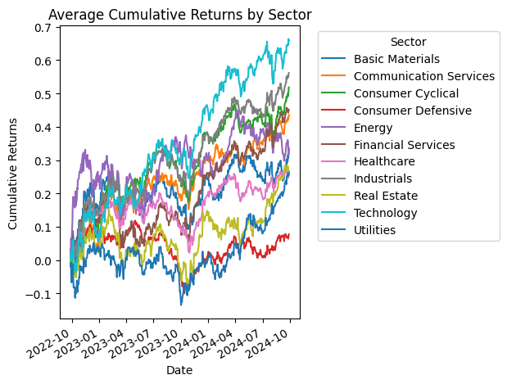
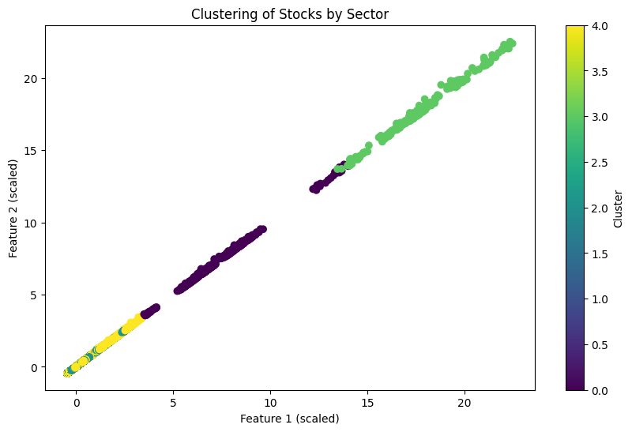
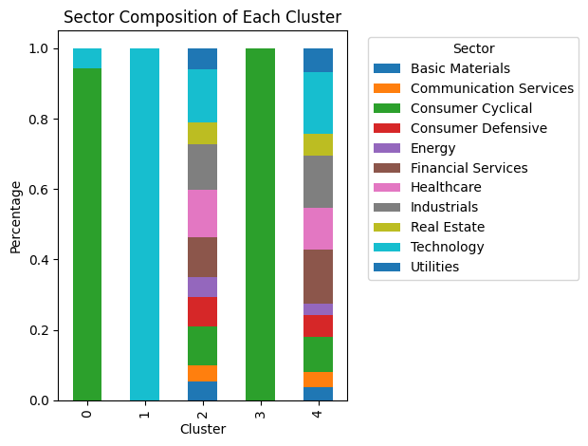
Some Plots.

Slide 25
What are Features?
Here's a simple explanation of RSI and the top features:
Relative Strength Index (RSI): RSI is like a speedometer for stock price movements. It measures how quickly and strongly a stock's price is changing. A high RSI suggests a stock might be overvalued, while a low RSI indicates it might be undervalued.
Price to Simple Moving Average (SMA) ratio: This compares a stock's current price to its average price over a set period. It's like comparing your current weight to your average weight over the past month. It helps identify trends and potential turning points.
Bollinger Band Percentage (BB_Pct): Imagine a river with its banks. Bollinger Bands are like those banks for stock prices. This percentage tells us where the price is within those banks, helping identify extreme movements.
MACD (Moving Average Convergence Divergence): MACD is like a compass for stock trends. It helps identify the strength, direction, momentum, and duration of a trend.

